Slide 1
WELCOME

Slide 2
PPT ON ATM MANAGEMENT SYSTEM
GANPAT UNIVERSITY
CSE CBA
MAIYANI URMIL
21162101013
ESSENTIAL OF SOFTWARE AND FOUNDATION PROGRAMMING -II
ACKNOWLEDGE BY : RAJESH K. JHA & UMANG R. THAKKAR

Slide 3
Concepts used in program
Header files → iostream, stdlib.h,string.h
SWITCH CASE
CLASS & OBJECT

Slide 4
HEADER FILES
iostream: iostream stands for standard input-output stream. This header file contains definitions of objects like cin, cout ,etc.
Stdlib.h : The header file stdlib. h stands for Standard Library. It has the information of memory allocation/freeing functions .
String.h : This function appends not more than n characters from the string pointed to by src to the end of the string pointed to by dest plus a terminating Null-character.

Slide 5
Concepts used in this program
Class and Object :
→ Class: The building block of C++ that leads to Object Oriented programming is a Class.
→ Object : An Object is an instance of a Class. When a class is defined, no memory is allocated but when it is instantiated (i.e. an object is created) memory is allocated.
Switch case : Switch case statements are a substitute for long if statements that compare a variable to several integral values. The switch statement is a multiway branch statement.

Slide 6
Built–in functions
int main() : 'int main' means that our function needs to return some integer at the end of the execution and we do so by returning 0 at the end of the program. 0 is the standard for the “successful execution of the program” .

Slide 7
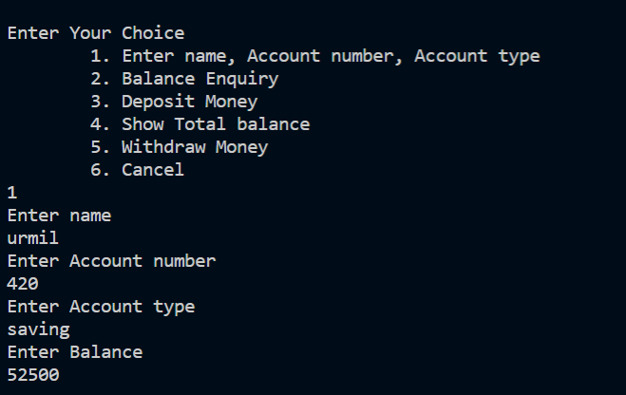
This shows output when we input 1 so we can enter name , Acc. Number,Acc. Type,Balance

Slide 8
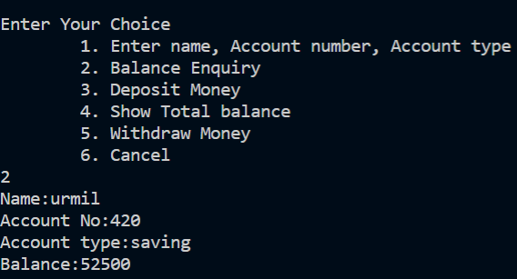
This will show output for balance enquiry when we input 2

Slide 9
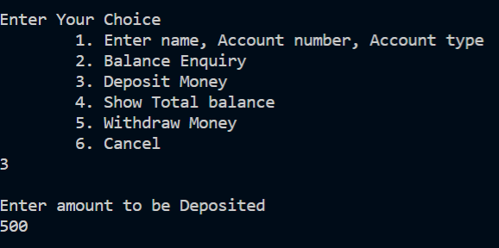
This will show output for amount we need to deposit when we enter input 3 .

Slide 10
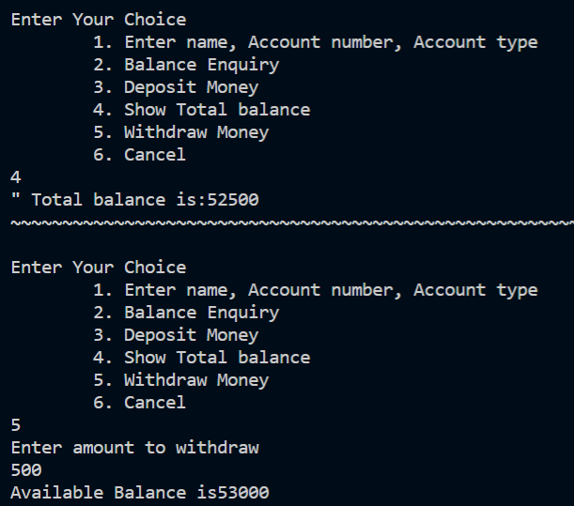
This shows output for total money & money we want to withdraw when we input 4 & 5 respectively

Slide 11
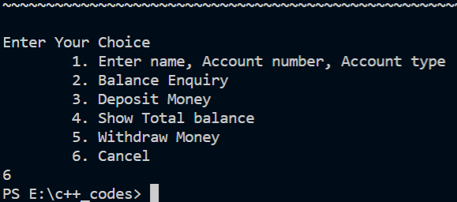
This will show output of input of 6 which will terminate the program

Slide 12
THANK YOU

